Slide 1
City of Wolfforth Technologies
GIS
Supervisory Control and Data Acquisition
To ensure we can sell most of what we produce.
Efficient production.
Storage
Allows the wells and system recovery time.
Electrodialysis Reversal
Provides high quality treated water at minimal loss.
Electronic and Radio Read meters

Slide 2
GIS
Well Management Websites
Wolfforth GIS Link
Well Management Site

Slide 3
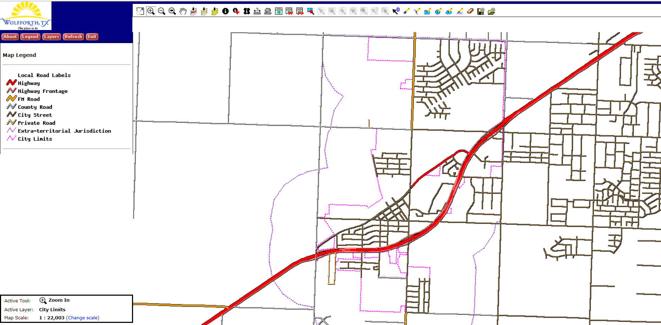

Slide 4
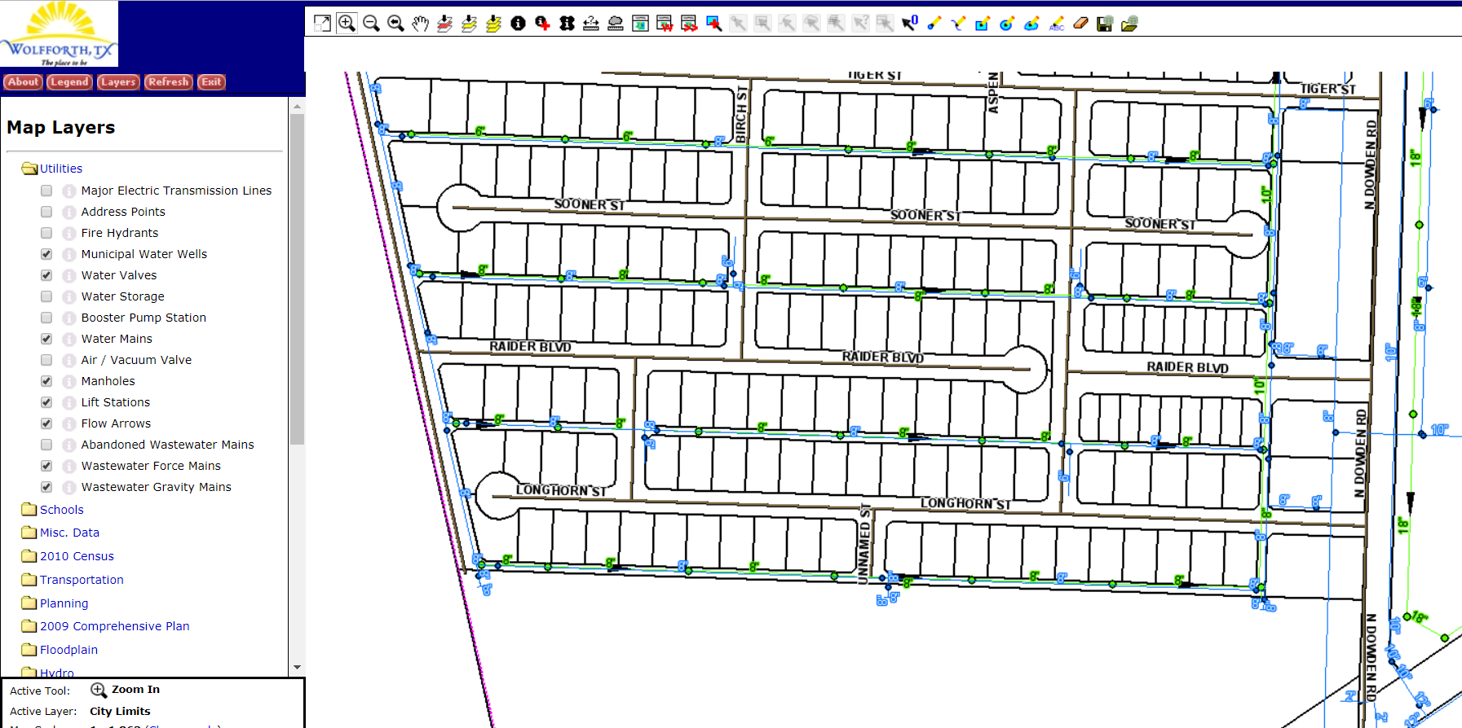

Slide 7
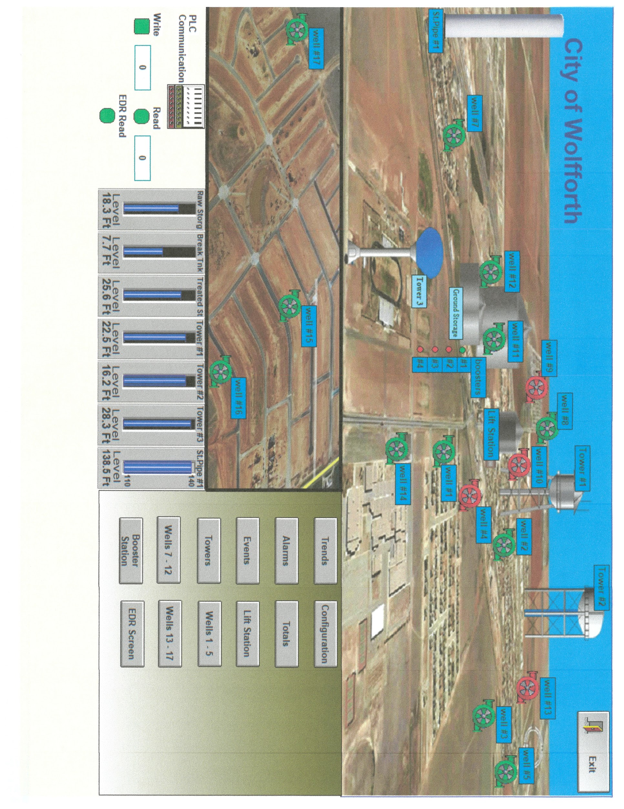

Slide 8
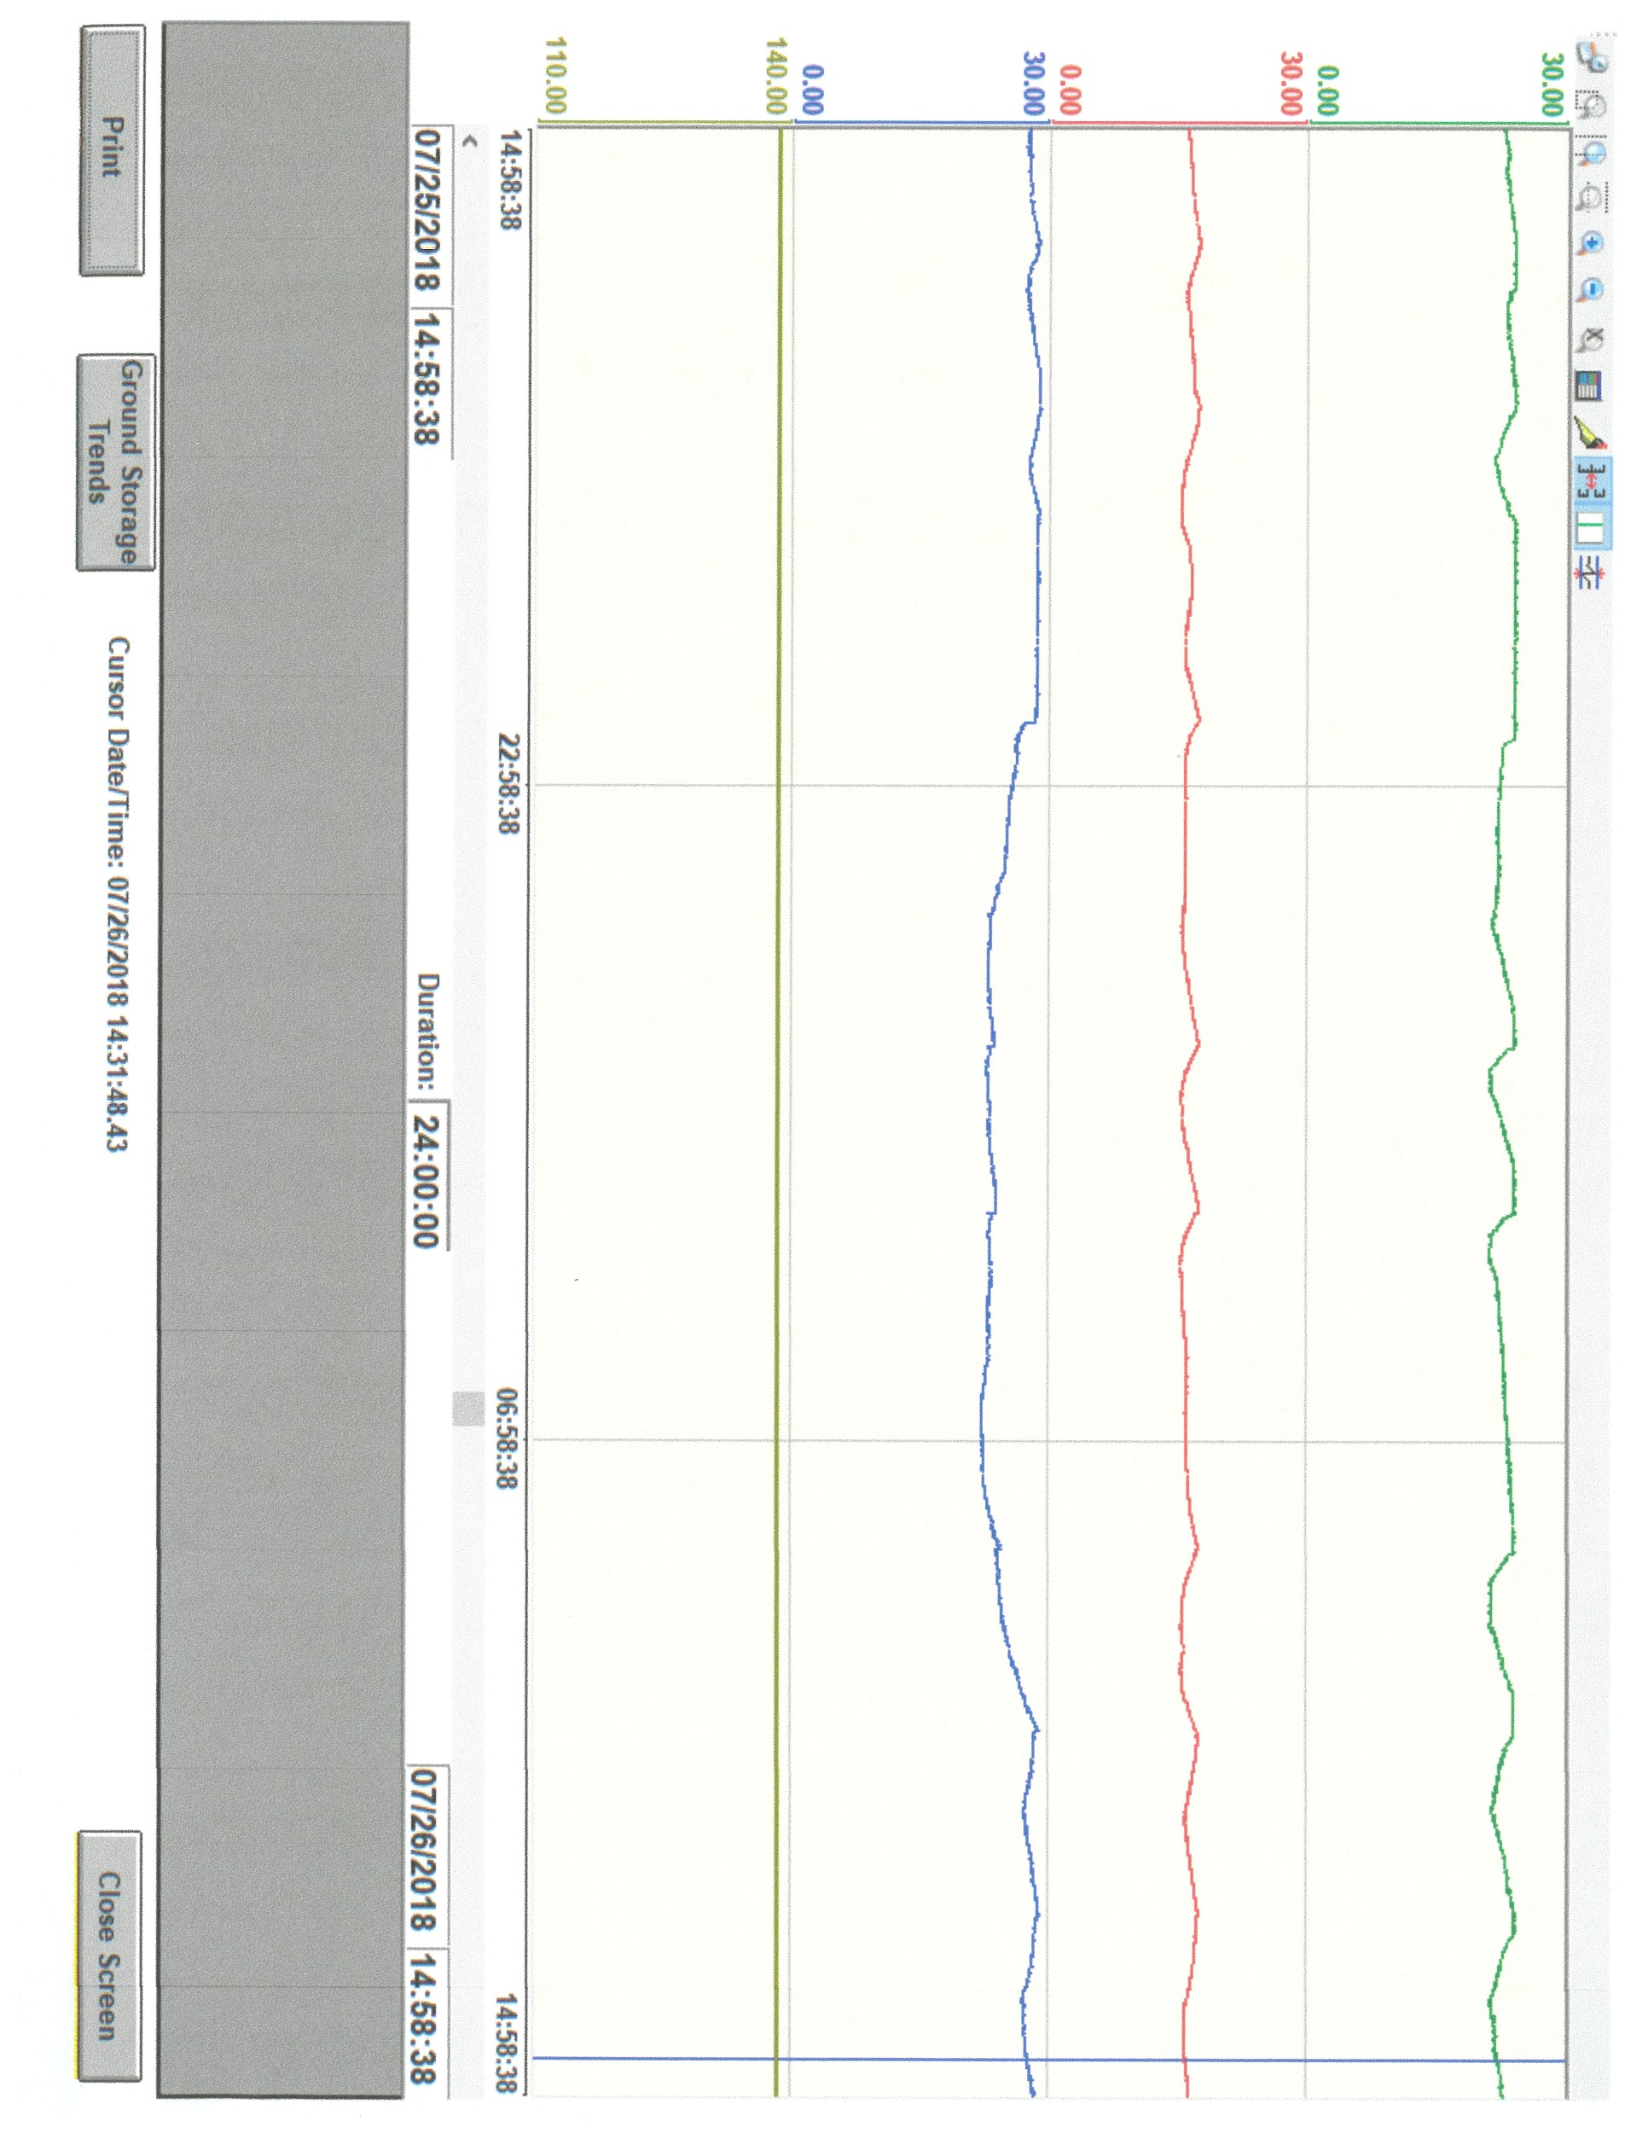

Slide 9
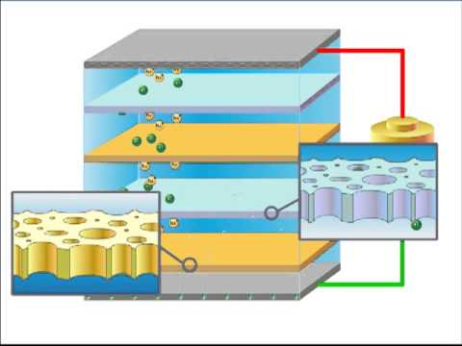
Electrodialysis Reversal

Slide 10
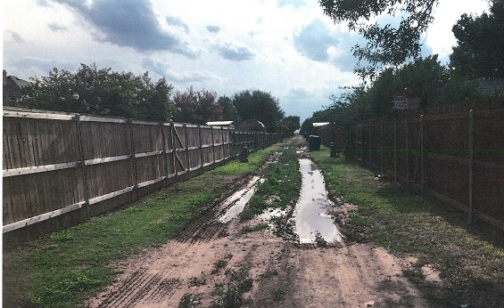

Slide 12
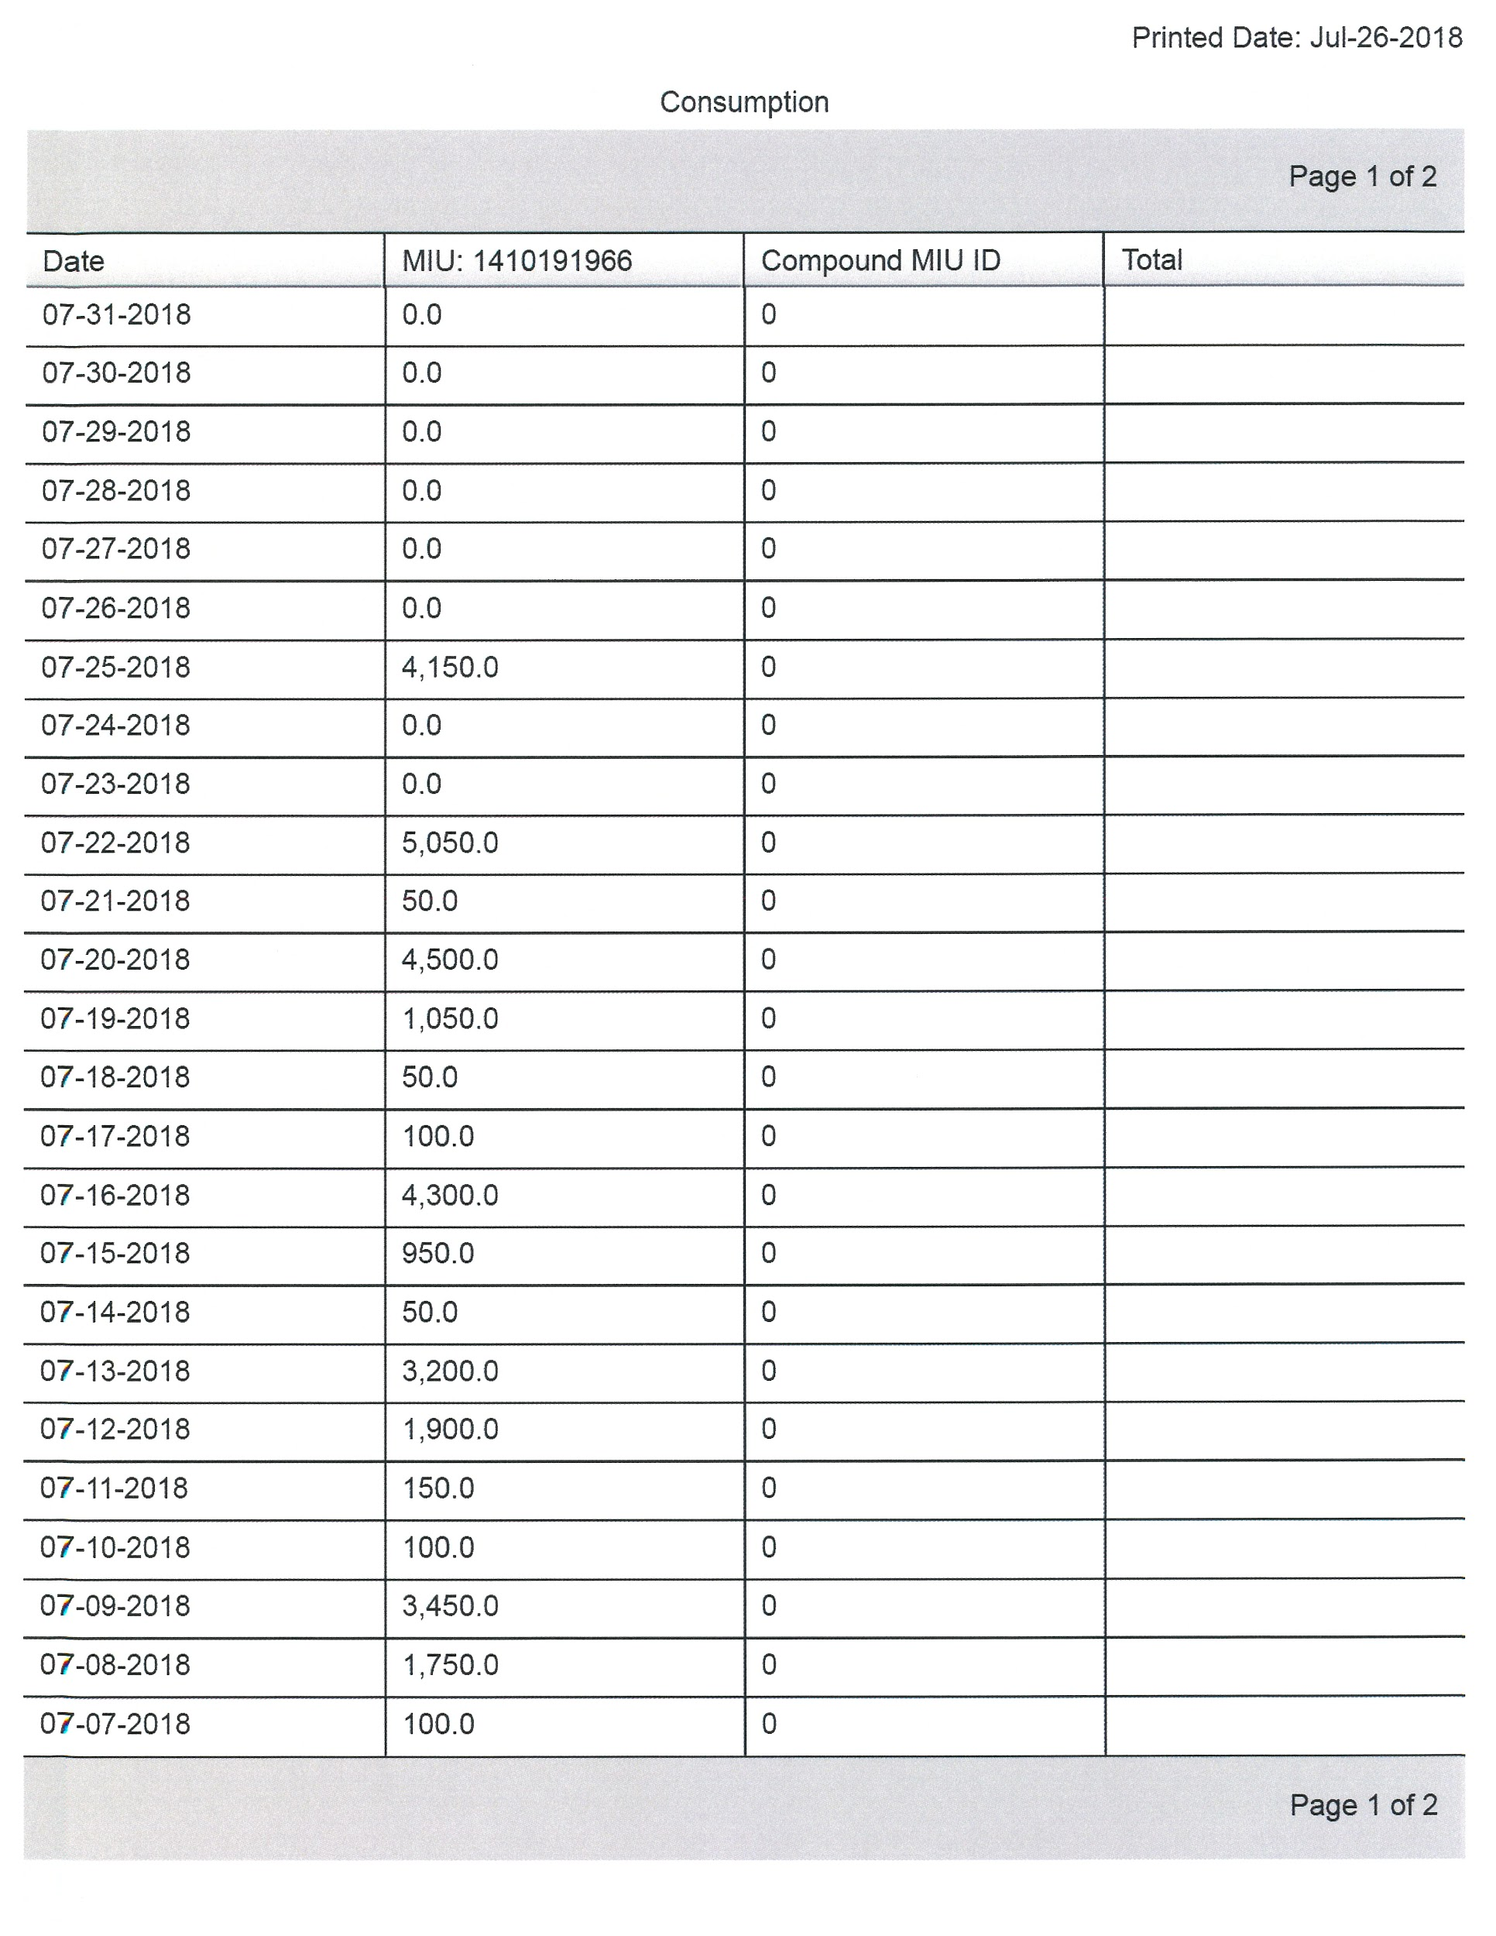
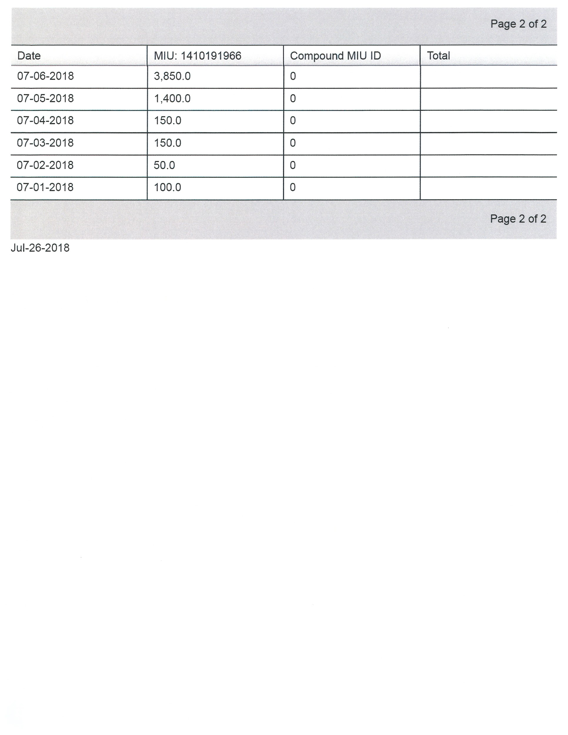

Slide 13
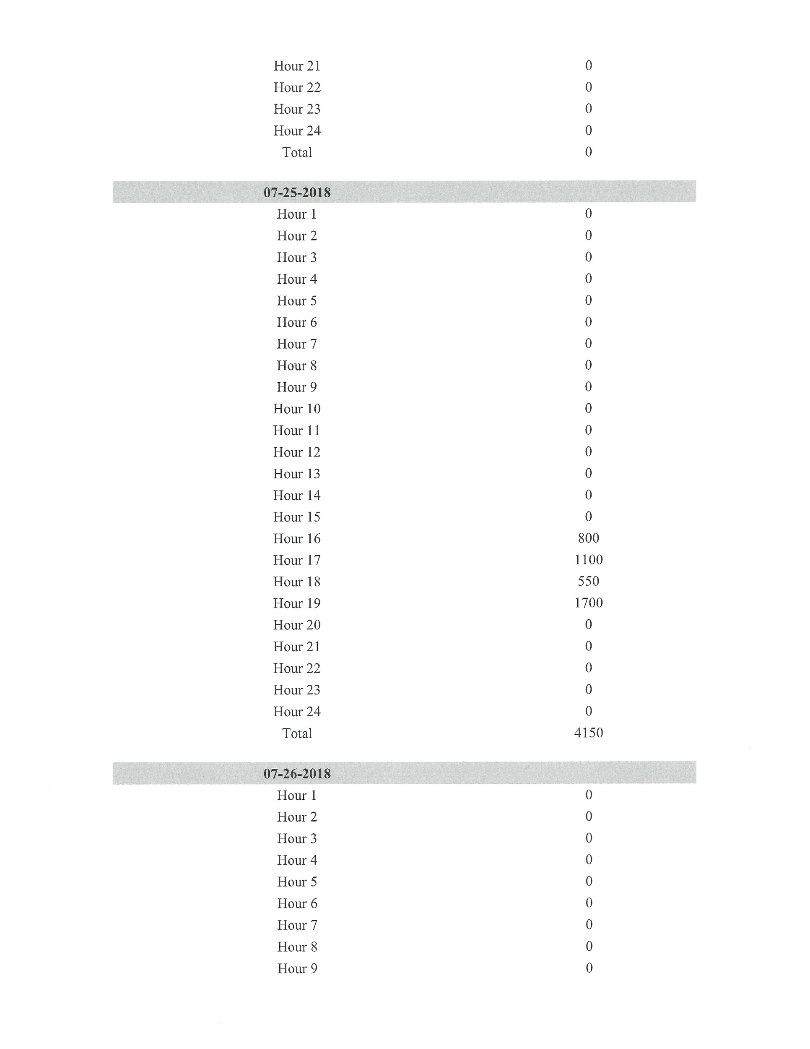

Slide 14
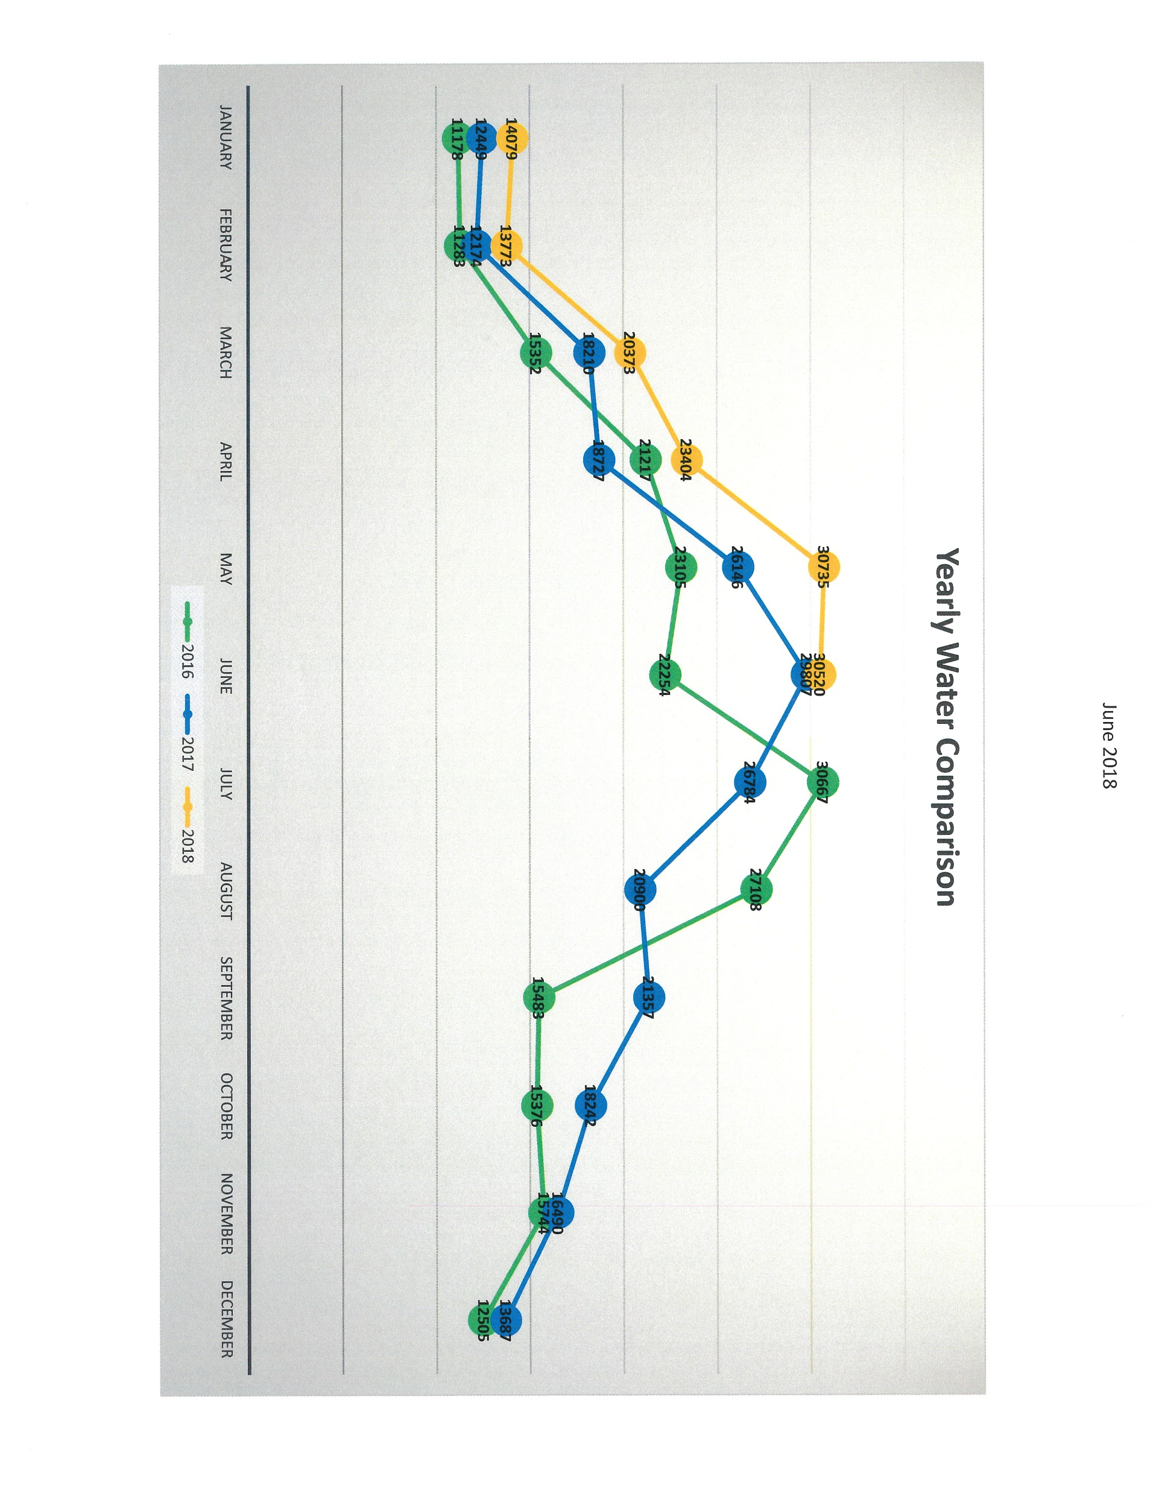

Slide 15
Challenges
Blending of old/new technologies
Regulatory issues
Funding and debt

Slide 16
Future options
Deeper brackish groundwater requiring desal
Sources farther from the City
Purchasing from other Cities, regional systems
Reuse
Ice Pigging

